Slide 1
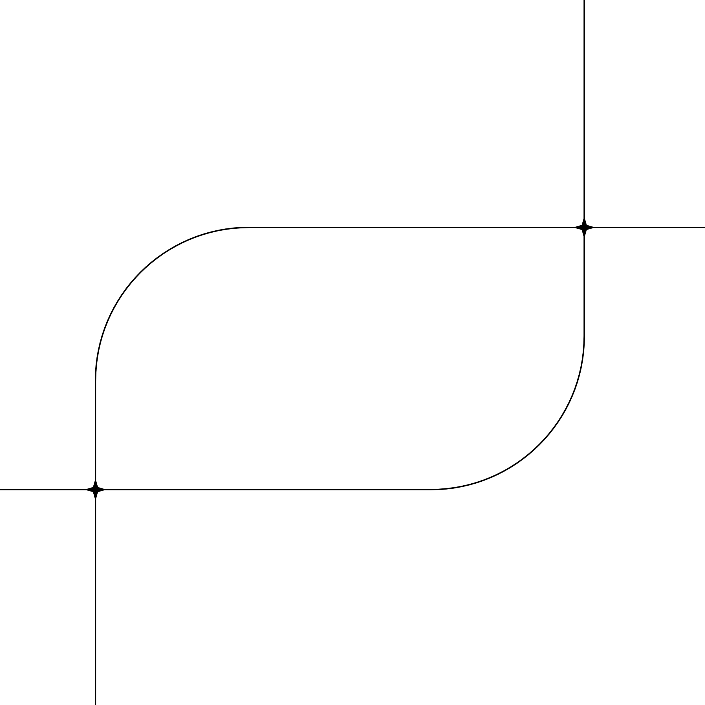
Shri Tuljabhavani College Of Engineering
Tuljapur-413601
Affiliated by Dr. BATU University
Title:- Sign Language Translator
Name:
1) Prathamesh Raut
2) Yogesh Reddy
3) Aniket Tandale
Guided By
Prof. S. E. Hajare

Slide 2
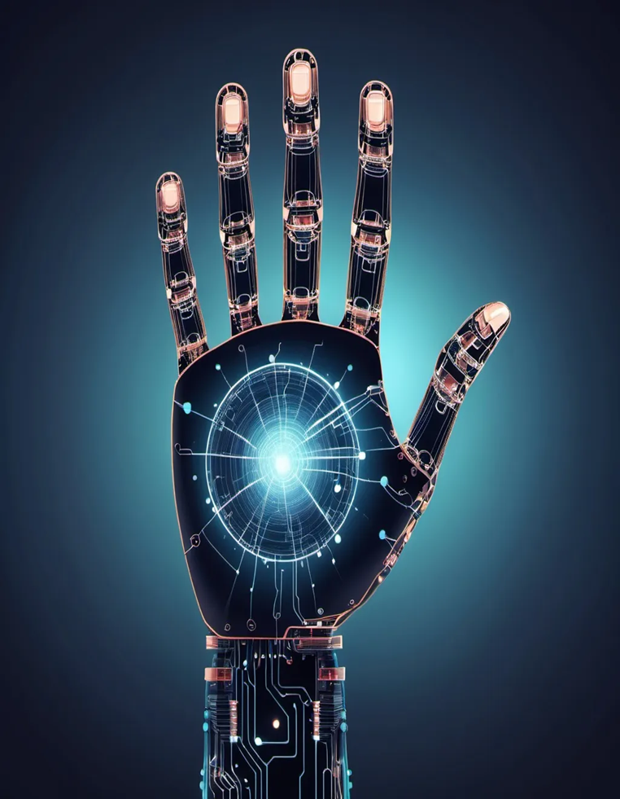
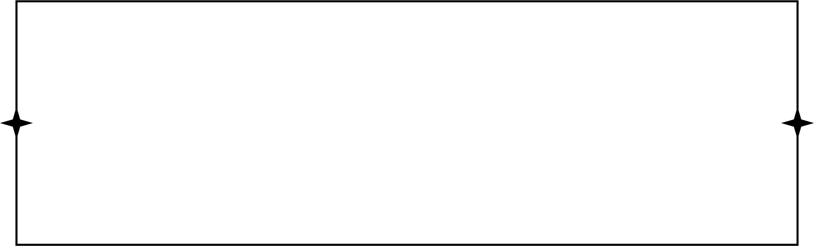
Introduction
SignSpeak is an AI-powered application designed to interpret sign language gestures into readable text.
It bridges the communication gap between hearing-impaired individuals and the rest of the world.
The system uses computer vision and machine learning to recognize hand gestures from images or webcam feeds.
It further supports multiple languages, enabling users to translate sign language into English, Hindi, and Marathi.
The project focuses on inclusivity, accessibility, and real-time interaction using modern technology.

Slide 3
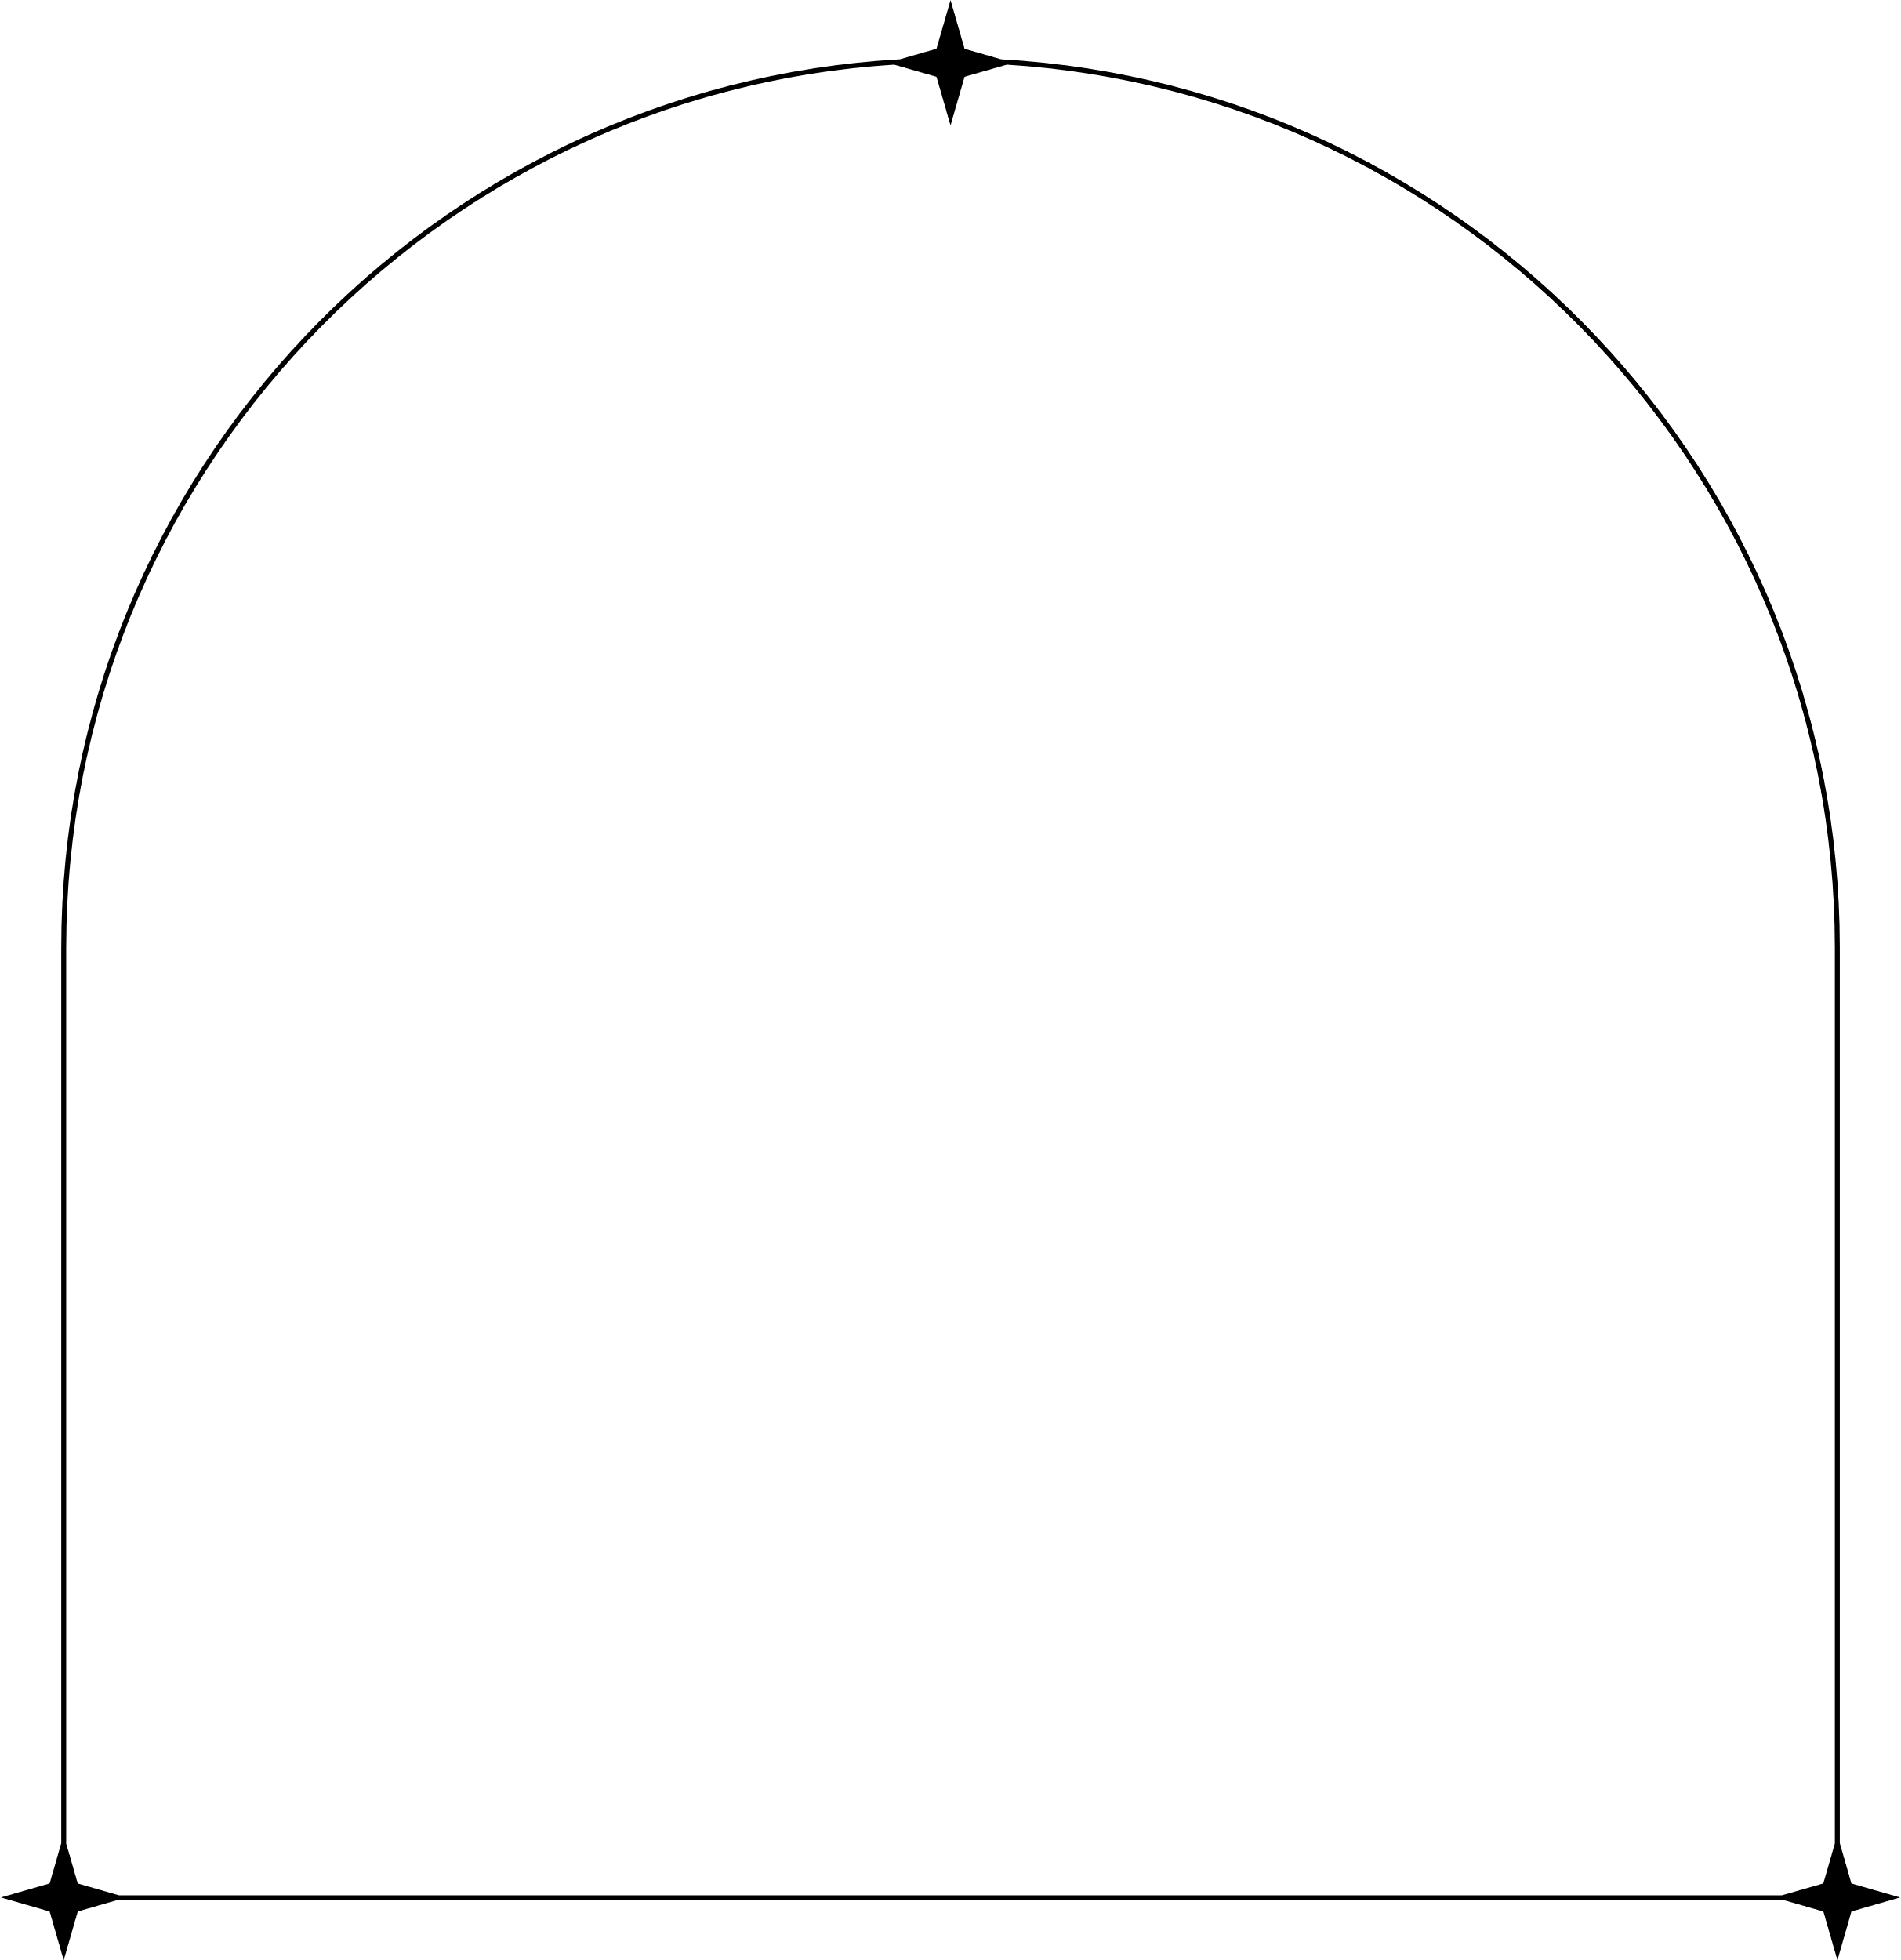

Problem Statement
Many hearing-impaired individuals face communication barriers in everyday life. SignSpeak aims to bridge this gap through real-time AI-based sign language recognition.
Objective
• Real-time translation of hand gestures
• Support for multiple languages
• Build meaningful sentence structures
• Make communication more inclusive

Slide 4

Technology Stack
• Python
• OpenCV
• TensorFlow (CNN)
• Flask (Backend)
• React(Frontend)
html
Css
Javascript
• Bootstrap (Styling)

Slide 5
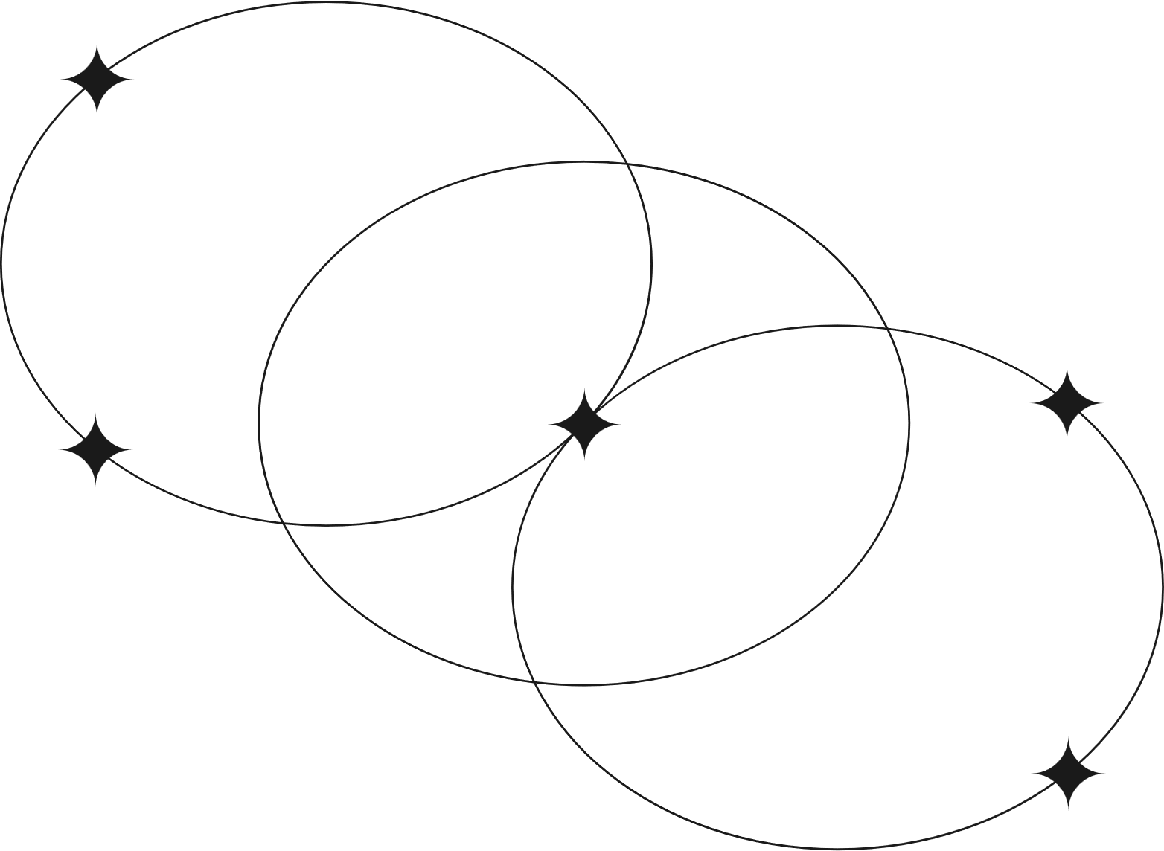
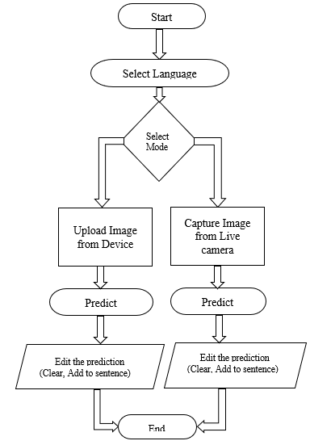

DataFlow Diagram

Slide 6
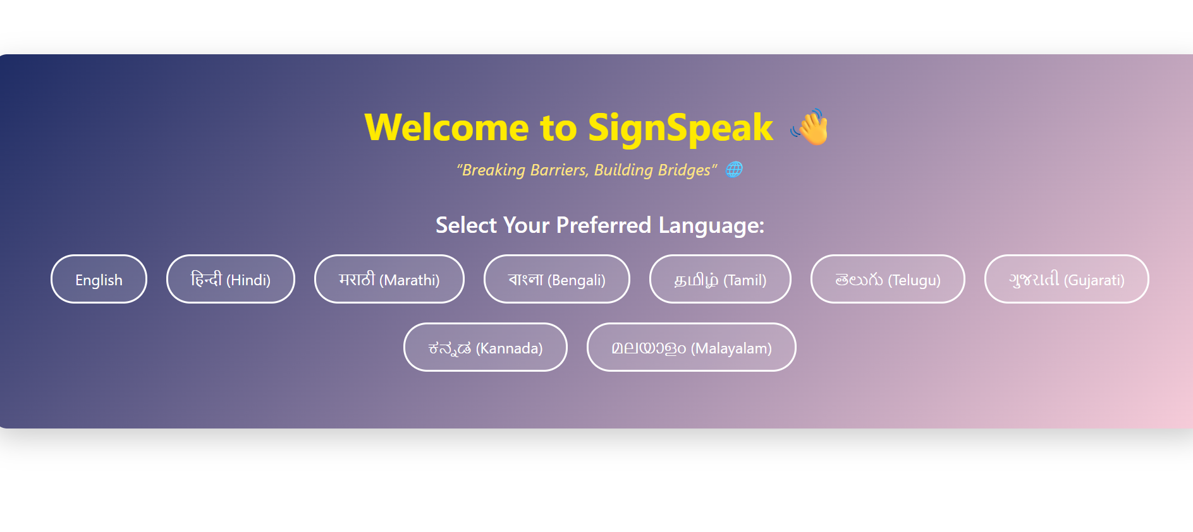
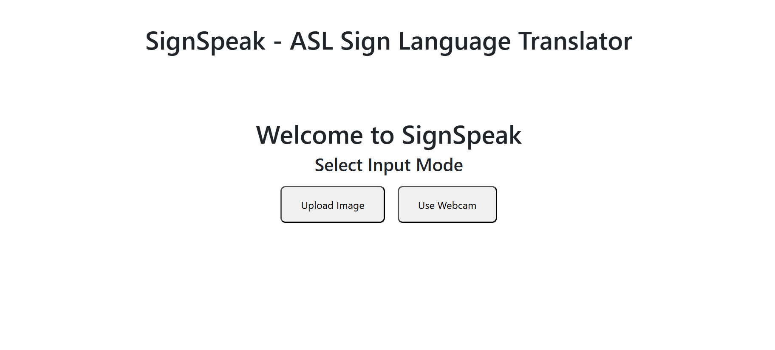
UI Examples

Slide 7
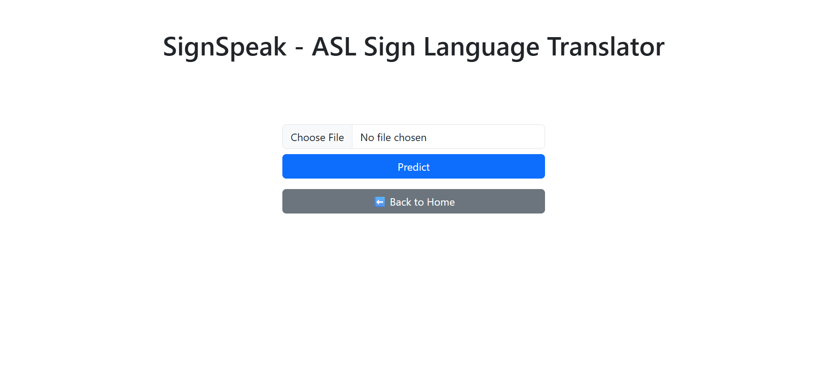
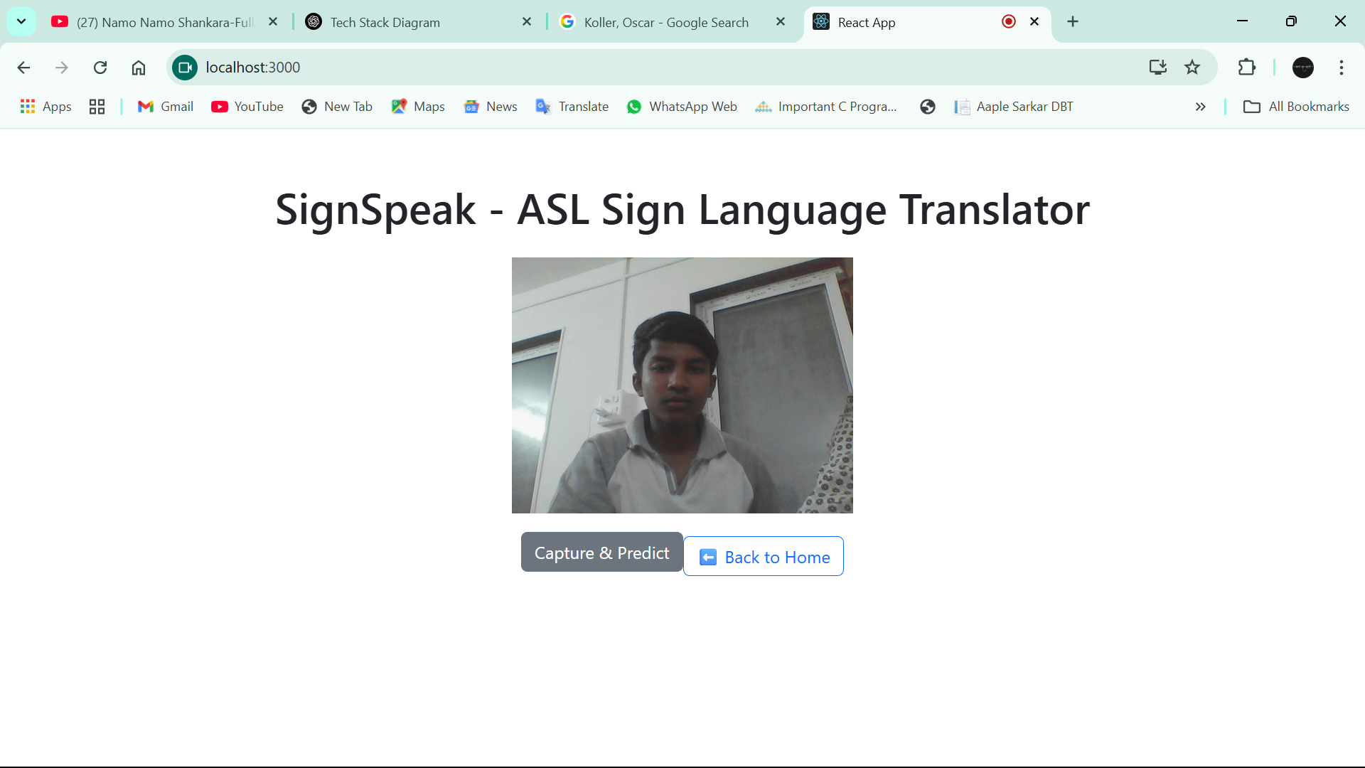
UI Examples
OR

Slide 8
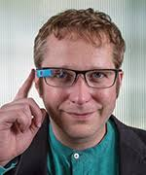
Reference
The Famous Researcher who took interest in solving the problem of deaf peoples
We take reference from their model and dataset to train our model
Koller Oscar
Deep Learning for Sign Language Recognition
Real-Time American Sign Language Recognition Using Desk and Wearable Computer-Based Video

Slide 9
conclusion
SignSpeak acts as a digital bridge between hearing-impaired and non-signers. With its modular AI-based approach, it enhances communication accessibility.
This is the Voice of speech-impaired and voice for deaf people.

Slide 10
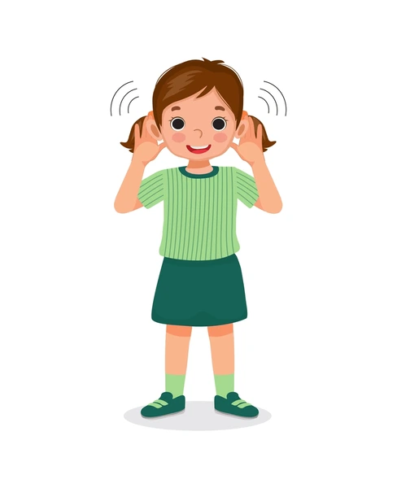

THANK
YOU

